Slide 1
Using GIT and Tortoise Git
Group Members
Chatur Veda Vyas Kurma S534687
Ganesh Siripuram S534915
Sanjana Baswapuram S534595
Sai Sree Dachepalli S534883

Slide 2




Ganesh Siripuram
Sai Sri Dachepalli
Chatur Veda Vyas Kurma
Sanjana Baswapuram

Slide 3
GIT and TORTOISEGIT
It is a Distributed Version Control System.
It is a free open-source Client for the Git Version Control System.
Manages Files over time.
Saves every changes made to local directory.
No loss of Data.

Slide 4
GITHUB
GitHub is a site for online storage of Git repositories.
You can get free space for open source projects or you can pay for private projects.

Slide 5
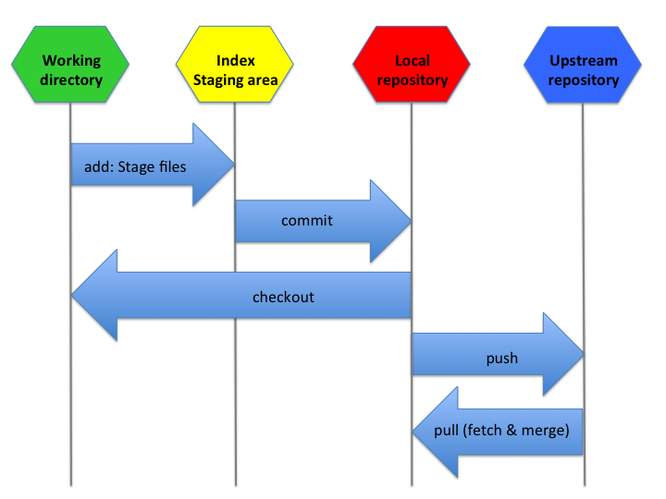

Slide 6
FEATURES
Shell Integration
Easy access to Git Commands
Atomic commits
Efficient handling of large projects
Strong support for non linear development.

Slide 7
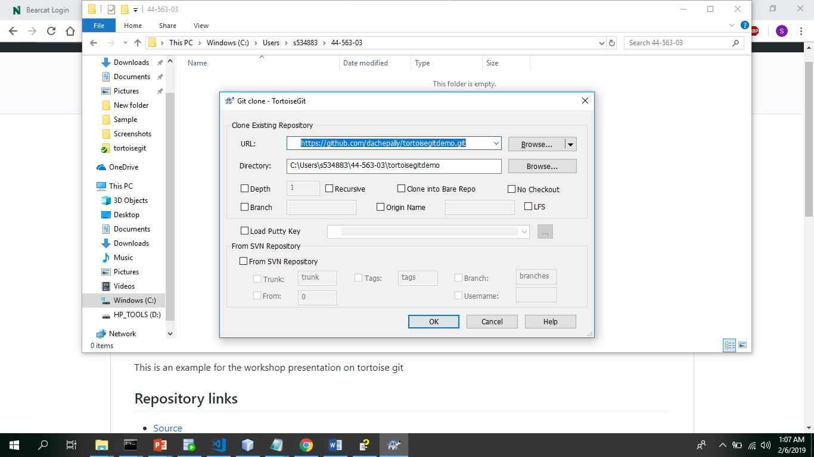
Clone Repository

Slide 8
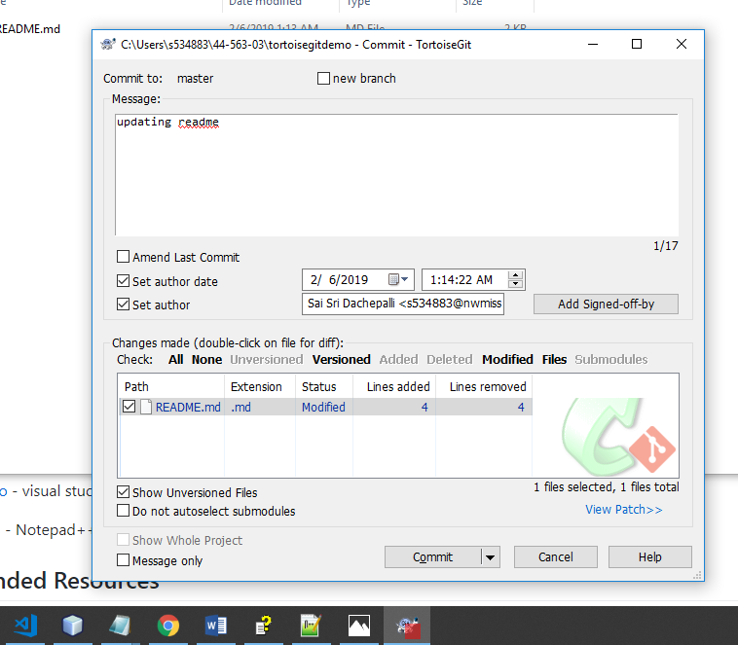
Git Commit

Slide 9
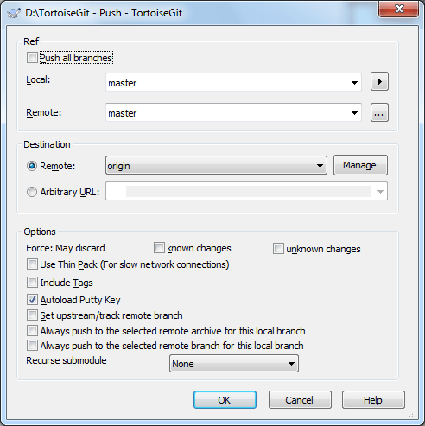
Git Push

Slide 10
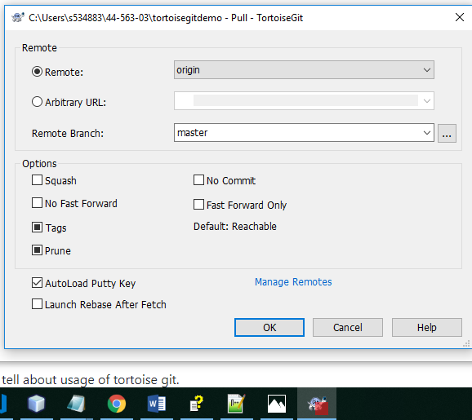
Git Pull

Slide 11
Difference between fetch and pull ?

Slide 12
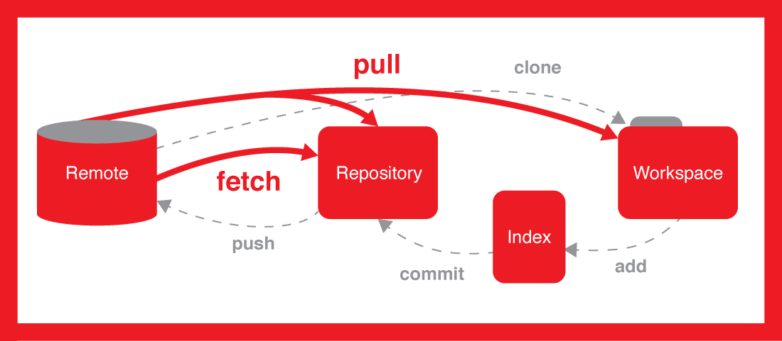

Slide 13
Using Powershell
By running commands on power shell.

Slide 14
References
https://www.microsoft.com/en-us/
Google Wikipedia
https://tortoisegit.org/docs/tortoisegit/
https://devops.com/library/

Slide 15
Any Questions ?

Slide 16
THANK YOU

